Slide 1
Personality-Guided Code Generation Using Large Language Models
Research paper: https://arxiv.org/pdf/2411.00006
Ppt by: Aishly Manglani

Slide 2
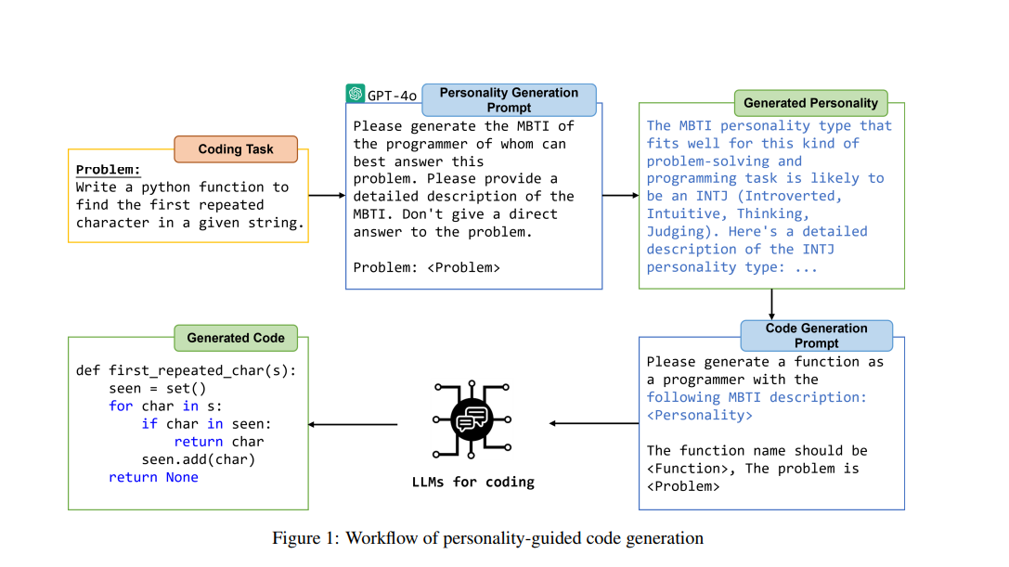
Introduction
Generating code using personality guided LLM for better performance. A comprehensive evaluation is conducted of personality-guided code generation using seven widely-used LLMs and four well-recognized datasets.

Slide 3
Key Idea
The study proposes a method in which LLMs are given different personality characteristics relevant to coding activities based on MBTI(Myers-Briggs Type Indicator)framework. This also helps to make sure that the models reflect “personalities” most appropriate for given tasks helping them make better decisions and be as accurate as possible.
Personality Generation: For a given coding task, we prompt GPT-4o, an advanced LLM for general text understanding, to generate an appropriate personality type most suited for solving the task. We adopt the Myers-Briggs Type Indicator (MBTI) framework.
Code Generation: Once the corresponding MBTI personality of a given task is generated, we move on to code generation. We prompt the LLM to take on the role of a programmer with the specified MBTI personality, providing a detailed description of that personality, and then it generates the code to solve the task.

Slide 4
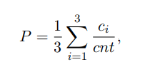
Experimental study
Evaluating personality-guided code generation using four widely recognized datasets: MBPP Sanitized , MBPP+ , HumanEval+ , and APPS .
We adopt seven LLMs for evaluation, consisting of four general-purpose LLMs and three specifically designed for code-related tasks. The general LLMs include GPT-4o , GPT-4o mini , Llama3.1 , and Qwen-Long, while the code specific LLMs include DeepSeek-Coder , Codestral , and CodeLlama.
The code generation accuracy is evaluated by calculating pass rate across all tasks in the dataset. The pass rate P of an LLM on a dataset is calculated as:
where cnt represents the total number of tasks in the dataset, and ci is the number of tasks successfully passed by the LLM in the ith run.

Slide 5
Results/Performance
#Overall, the personality-guided approach improves the pass rate of code generation in 23 out of 28 combinations of LLMs and datasets.
#The LLM’s performance, dataset difficulty, and personality diversity are potential factors influencing the effectiveness of personality-guided code generation. LLMs with moderate performance benefit more than those with either very strong or very weak performance.
#Overall, using GPT-4o for personality generation outperforms using each LLM individually for this task.

Slide 6
Conclusion
While existing research typically involves LLMs role-playing as programmers to generate code, this research investigates whether assigning these “programmers” with appropriate personalities can further improve code generation accuracy. To explore this, an extensive evaluation is conducted using four widely-adopted datasets and seven advanced LLMs. The results show that personality guidance significantly enhances code generation accuracy, with pass rates improving in 23 out of 28 LLM-dataset combinations. Notably, in 11 cases, the improvement exceeds 5%, and in 5 instances, it surpasses 10%, with the highest gain reaching 12.9%.

Slide 7
Limitations
The personality traits examined are limited to the MBTI framework.
Even after evaluating seven LLMs, including both general-purpose and code-task-specific models, the generalizability of the findings to other LLMs requires further research.

